Slide 1

CHALLENGE #8 Sentiment Analysis of Observation Data
Users enter comments into our Observation app, but generic tools struggle with construction terms, British English, and sarcasm. Are we able to get better indication of sentiment from the data?

Slide 2



Technology used
Python
Machine Learning
TextBlob
Library
Common sentiment analysis
Input text, output polarity and subjectivity
PowerBI

Slide 3
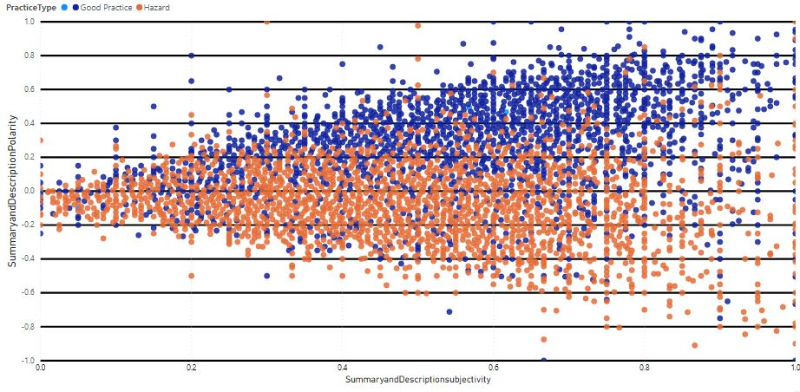
Too many people using 1 Welfare unit. 11 people! 1 microwave! 30 minute break!
Jordan has been moved from gate to gate but instead of complaining he just got on with it and continued to work hard !!!! Employee of the month ????
Alan Faulks Roller Driver not using walkways and crossing; cutting corners was spoken to and asked to change behaviour or walk!

Slide 4
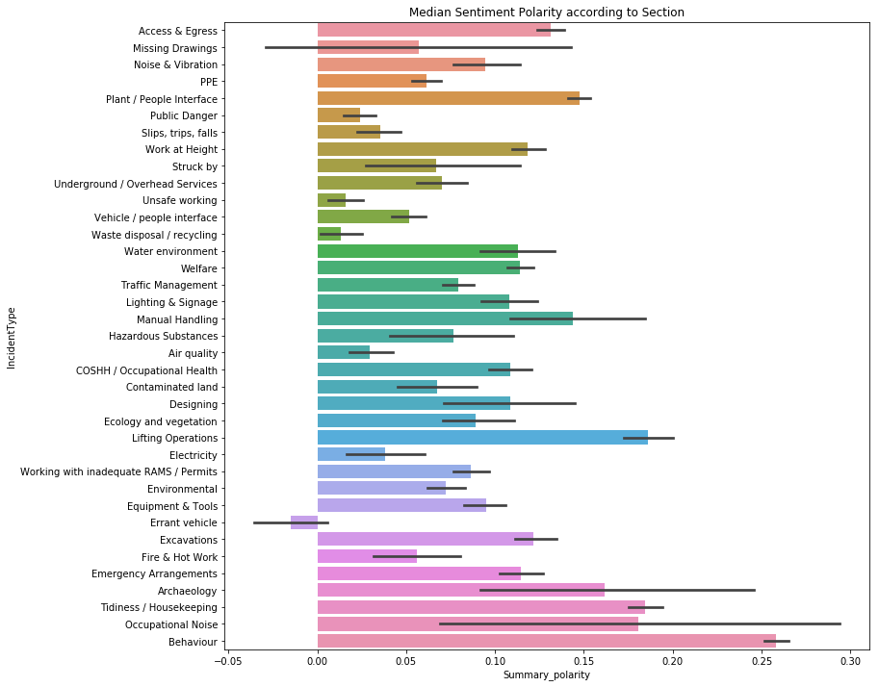
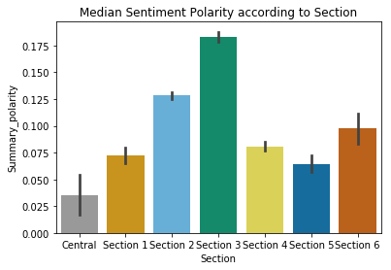
Project Insights

Slide 5
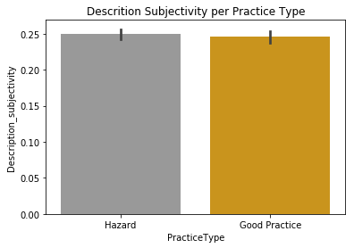
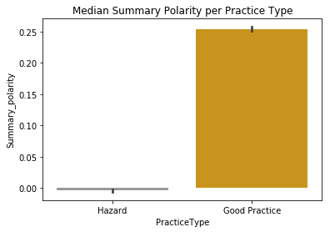
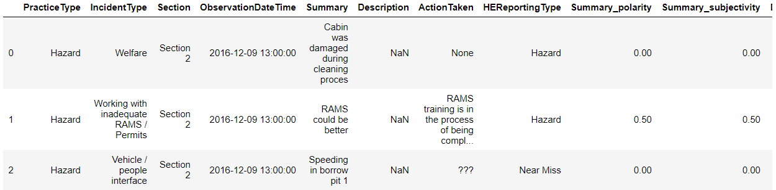
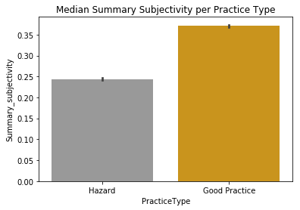
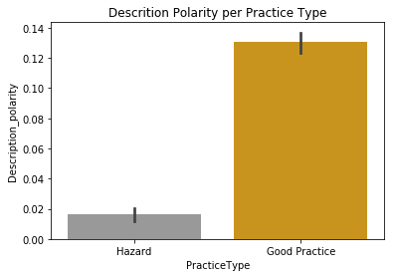
Predictive Analytics
Validating TextBlob Model
‘Practice Type’ predicted by analysis of natural language
Comparison against actual completed field
Digger jammed
-0.10
Fell downstairs
-0.15
Nice one mate, you screwed that one up
0.60

Slide 6
Benefits, Innovation & Commercial Application
Reduce user form filling
Unstructured data
Quantitative score from unstructured data
Return insights from natural language
Supports adoption of site technology
Most contractors have a similar observation system
Potential of voice recognition.
Lower training requirements
People centric
Support wellbeing
Measure of sentiment as part of day to day activities

Slide 7
Summary & Going Forward
Increase data sources
Feedback to language model
Teach it ‘construction speak’
Use of other language models
Link between types of hazard and sentiment – does sentiment directly correlate with level of risk?
How is sentiment linked to other data types:
Time of day?
Weather?
Traffic data?
Forensic investigation – was an event predictable by previous observation sentiment

